Slide 1
Intelligent User Experience
Developing a child-driven online education environment for third world countries

Slide 2
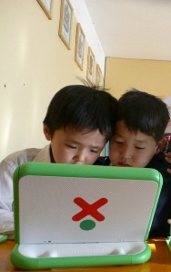
Project goal
Develop an intuitive and easy-to-use
online learning environment that would facilitate self-organised group-based learning for the young children not having access
to experienced teachers and printed books.

Slide 3
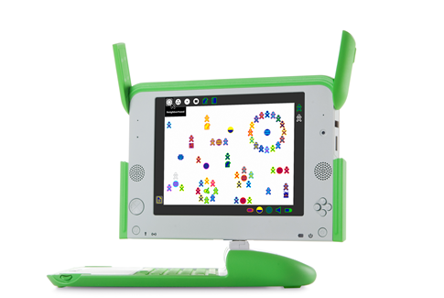
Ideas
Use an avatar exploiting “granny’s effect”
Develop for One Laptop Per Child platform
Build a system oriented to process-oriented challenges requiring study of computer applications and internet

Slide 4
OLE structure
Challenge database: storage
Student interface: usage
Teacher interface: creation
Management panel: control

Slide 5

Scenarios
Adding a challenge
Lisa, 30 years, NL
Tells her pupils about the sun and wants to create a challenge about it in a system.
She logs in and adds a challenge with two questions:
What is the weight of the sun?
Why do plants need sunlight?

Slide 6
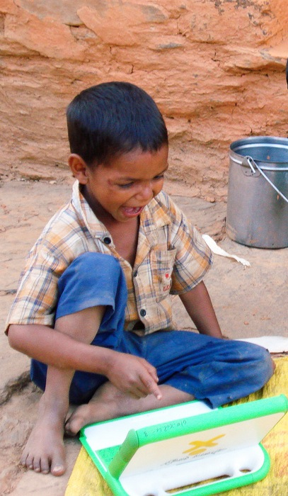
Scenarios
Solving a challenge
Raja, 11 years, IN
Avatar asks him to find the weight of the sun.
Raja’s friend shows him how to open a browser and what to do.
Raja finds the answer and gives it to the system.
The avatar thanks Raja and asks another question.

Slide 7
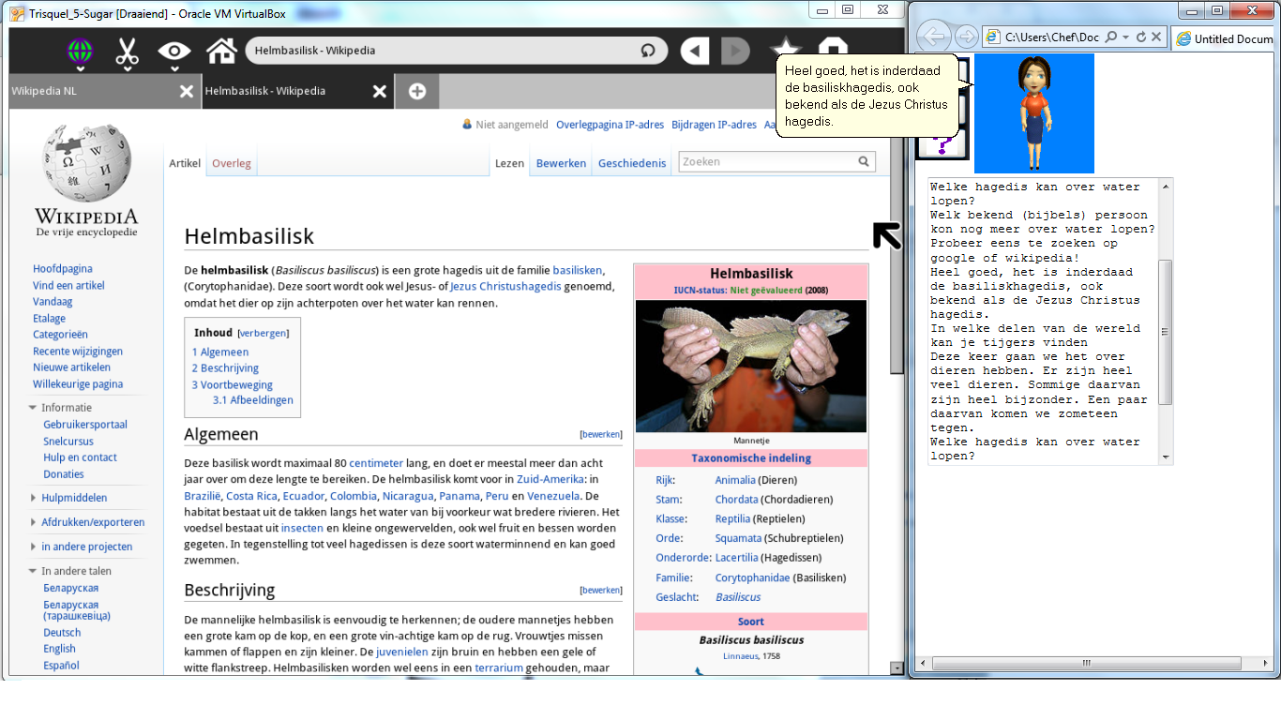
Pilot project
Student interface in JavaScript with Agent Helper API
Works in separate browser window
SugarOS works in a virtual machine

Slide 8
Testing setup
Procedure
Create a set of sample activities
Inform participants about the test
Conduct experiment: provide students with laptops with system run and evaluate their behaviour
Evaluate with questionnaire and interview

Slide 9
Testing setup
Claims
The avatar motivates the user to learn about a certain topic and asks questions that allow the user to reflect back on his progress thus improving learning.
Using the tool the user gains more knowledge about the world and understands it better.
Working in groups may increase the learning rate as this introduces a social aspect as well.

Slide 10
Testing setup
User experience measures
Encouragement: do students find it interesting to work with the assistant and complete the suggested challenges.
Usability: do students feel themselves comfortable while working with the system or it is counter-intuitive/complex/etc.?
Group work: do students find it more educational/fun to work in groups?

Slide 11
Testing setup
Focus groups
First stage: testing with TU students
Seven persons
Three individuals, two groups of two
Second stage: testing with children of age 9-15
Fifteen persons
Two individuals, five groups of size two and three
Some participants work with a system with no avatar.

Slide 12
Testing results
General feedback
Overall impressions are good but avatar improvements needed.
Participants using the avatar showed better results.
Almost all participants answered all the questions.
Participants tried to associate avatar with themselves.
Avatar of same gender is rated higher.
Hints sometimes confusing, speed unsatisfactory.

Slide 13
Testing results
Group work
Groups generally perform better than individuals.
Individuals focus on questions, groups focus on process.
Avatar needs to encourage communication within the group.
Less experienced group members participate less.

Slide 14
Testing results
Claims validation
All the claims are proven to be correct:
Avatar motivates children to learn
Avatar helps to gain knowledge about the world
Group work increases learning rate

Slide 15
Challenges
How to retrieve the feedback for process-oriented tasks?
How to deal with localisation issues?
How do avatar characteristics affect the involvement?
Group of what size perform better?

Slide 16
Recommendations
Agent Helper avatar functionality insufficient, better needed
Face-only avatars with rich facial expressions are best
Quality of text-to-speech engine is crucial
Beta-testing on large focus groups is needed
More challenges are needed for the focus groups

